Slide 1

Final Project
Real-time Stream Processing using Kafka and Storm
Alexandre de Melo Correia Pinto
csci e185 Big Data Analytics
Harvard Extension School
@alexcpsec

Slide 2

Agenda
Motivation for Real Time Streaming
Kafka
Storm
Demo Discussion
@alexcpsec

Slide 3

Motivation for Real Time Streaming
Batch processing has been a staple of Big Data for 10 years now.
Requirements evolved to real-time:
  Continuous computation
  Online machine learning (“blackout” hashtag in SuperBowl)
Real-time has different requirements, no “patching Hadoop”
  Scalability
  Prevent data loss
How to make this painless?
@alexcpsec

Slide 4

Kafka – What is it?
Apache Kafka is a distributed publish-subscribe messaging system:
  Persistent messaging with O(1) disk structures ;
  High-throughput: hundreds of thousands of messages per second.
  Explicit support for partitioning messages over Kafka servers;
  Support for parallel data load into Hadoop.
Created and runs on Linkedin – a “modest” use case.
Made for offline and online processing.
Structured like a “traditional messaging system”
@alexcpsec

Slide 5
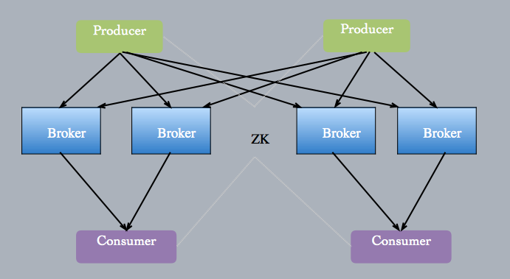


Kafka – Architecture
Producers and Consumers connect to Brokers
They exchange information on Topics over partitions
Messages are persistent and can be queried from any point in chain.
@alexcpsec

Slide 6
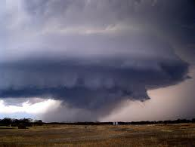
Storm – What is it?
Storm exposes a set of primitives for doing real-time computation. The key properties are:
  Extremely broad set of use cases: Storm's small set of primitives satisfy a stunning number of use cases.
  Scalable
  Guarantees no data loss (a big one – ack infrastructure)
  Fault-tolerant
Created by a company called BackType:
  Acquired by Twitter on 2011
  Another “modest” use case
@alexcpsec

Slide 7
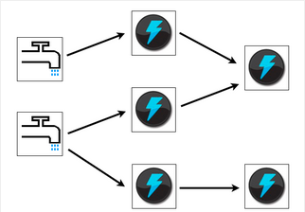

Storm – Architecture
Data flows from Spouts to Bolts in a computation chain
Each node performs a bit of computation according to their local code on the data they receive and “emit” a new data unit down the chain and “acks”.
If node fails, data will not have received “acks” and is sent again to other node.
@alexcpsec

Slide 8

Kafka + Storm = AWESOME!
@alexcpsec

Slide 9

Demo Program
Let’s put Kafka and Storm together!
Implementation of a Very Complicated WordCount ™
  Kafka Producer to stream a text file to a topic
  Sprout that reads from Kafka topic and computes the WordCount through a series of Bolts
Cool part:
  Multiple streams from Kafka, from anywhere, persistent messaging
  Bolts perform the computation autonomously
    More data = more computation
Not so cool part:
  Lot of work setting up the environment.
@alexcpsec

Slide 10
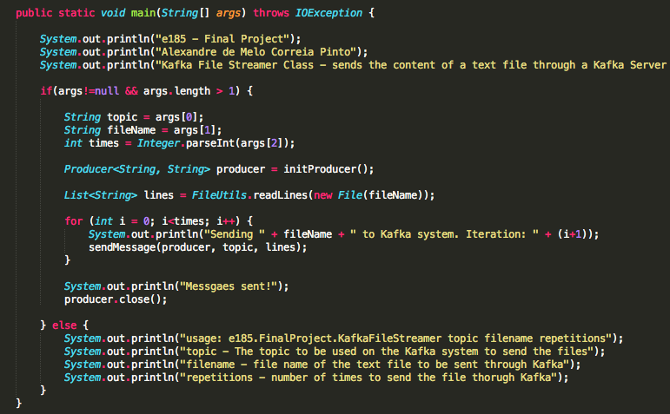
Demo Architecture
Kafka Producer – KafkaFileStreamer.class
  Sends the data to a Kafka Broker registered with the local Zookeeper
  Streams the chosen file N number of times
@alexcpsec

Slide 11
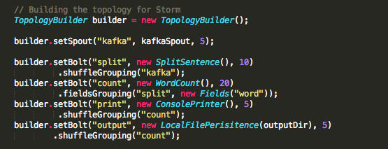
Demo Architecture
Storm Consumer and Processor – StormWordCountLocal.class
  Reads the data from a Kafka Spout (tough guy to compile)
  Runs through a couple of Bolts for Word Count
  Sends WordCount to parallel Bolts, that write to console and to file.
@alexcpsec

Slide 12
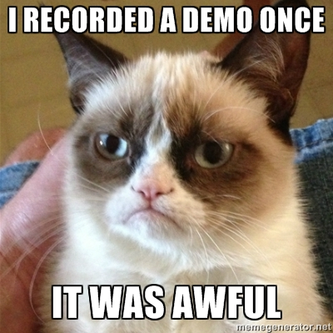
Demo Time!
@alexcpsec

Slide 13
THANK YOU!
Alexandre de Melo Correia Pinto
@alexcpsec
csci e185 Big Data Analytics
Harvard Extension School
@alexcpsec

